Slide 1






Micro Credit Defaulter Project
Submitted by:
Akshaykumar B Torangatti

Slide 2
Work Flow
Define the problem statement, Objective, Targets, Expected Improvement appropriately.
Collect the data. The more and better the data, better is Analysis.
Exploratory Data Analysis, check for the information, check for null values, different datatypes available, dealing with missing values if any, Check for outliers, Checking the statistical overview of the data.
Understand the relationship between the attributes, apply the visualization techniques to draw the relationship and what inferences are they making.
Note down the observations based on the visualization graphs we have created.
Write down the detailed data analysis and Conclusion.

Slide 3
Introduction
A Microfinance Institution (MFI) is an organization that offers financial services to low-income populations. MFS becomes very useful when targeting especially the unbanked poor families living in remote areas with not much sources of income. The Microfinance services (MFS) provided by MFI are Group Loans, Agricultural Loans, Individual Business Loans and so on.
Many microfinance institutions (MFI), experts and donors are supporting the idea of using mobile financial services (MFS) which they feel are more convenient and efficient, and cost saving, than the traditional high-touch model used since long for the purpose of delivering microfinance services. Though, the MFI industry is primarily focusing on low-income families and are very useful in such areas, the implementation of MFS has been uneven with both significant challenges and successes.
One of microfinance working in telecom sector are collaborating with an MFI to provide micro-credit on mobile balances to be paid back in 5 days. The Consumer is believed to be defaulter if he deviates from the path of paying back the loaned amount within the time duration of 5 days. For the loan amount of 5 (in Indonesian Rupiah), payback amount should be 6 (in Indonesian Rupiah), while, for the loan amount of 10 (in Indonesian Rupiah), the payback amount should be 12 (in Indonesian Rupiah).

Slide 4
Micro Credit and its importance
Microcredit is a common form of microfinance that involves an extremely small loan given to an individual to help them become self-employed or grow a small business.
Today, microfinance is widely accepted as a poverty-reduction tool, representing $70 billion in outstanding loans and a global outreach of 200 million clients.
Micro credit solution provides operators and service providers with the ability to extend their service to their users through a small, short term credit facility. When we go through the dataset provided, we are supposed to examine methodically all the attributes provided, classify the customers between defaulters and non-defaulters and reduce the chances of fraudulence micro credit loan by users.

Slide 5
Importing Libraries
To start with, we import all the necessary libraries required in performing all the steps of data analysis. We have imported the following libraries
NumPy, Pandas :
NumPy is a library for Python that adds support for large, multi-dimensional arrays and matrices, along with a large collection of high-level mathematical functions to operate on these arrays. Pandas is a high-level data manipulation tool that is built on the NumPy package.
Matplotlib.pyplot, Seaborn:
Matplotlib is a plotting library for the Python programming language and its numerical mathematics extension NumPy.
Seaborn is a Python data visualization library based on matplotlib which provides a high-level interface for drawing attractive and informative statistical graphics.

Slide 6
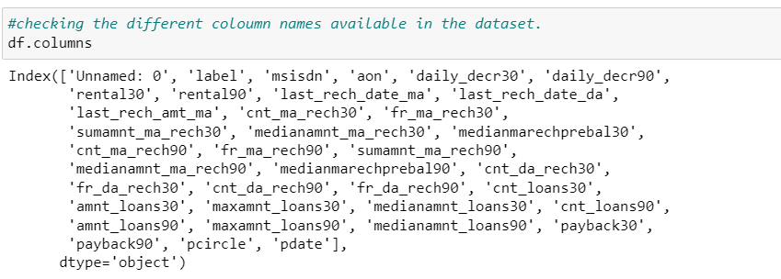
Dataset Information
The sample data is provided to Flip Robo from their client database.
It is hereby given to me for this exercise. The data provided is in the form csv file, I’ll be converting it into DataFrame to perform basic operations on rows/columns like selecting, deleting, adding, and renaming. To improve the selection of customers for the credit, the client wants some predictions that could help them in further investment and improvement in selection of customers.
There are 209593 rows and 37 columns in the dataset provided. All the attributes are numerical datatypes except ‘pCircle’ and ‘pdate’.

Slide 7
Description of the dataset
Index | Variable | Definition
1 | label | Flag indicating whether the user paid back the credit amount within 5 days of issuing the loan{1:success, 0:failure}
2 | msisdn | mobile number of user
3 | aon | age on cellular network in days
4 | daily_decr30 | Daily amount spent from main account, averaged over last 30 days (in Indonesian Rupiah)
5 | daily_decr90 | Daily amount spent from main account, averaged over last 90 days (in Indonesian Rupiah)
6 | rental30 | Average main account balance over last 30 days
7 | Rental90 | Average main account balance over last 90 days
8 | last_rech_date_ma | Number of days till last recharge of main account
9 | last_rech_date_da | Number of days till last recharge of data account
10 | last_rech_amt_ma | Amount of last recharge of main account (in Indonesian Rupiah)

Slide 8
Description of the dataset
Index | Variable | Definition
11 | cnt_ma_rech30 | Number of times main account got recharged in last 30 days
12 | fr_ma_rech30 | Frequency of main account recharged in last 30 days
13 | sumamnt_ma_rech30 | Total amount of recharge in main account over last 30 days (in Indonesian Rupiah)
14 | medianamnt_ma_rech30 | Median of amount of recharges done in main account over last 30 days at user level (in Indonesian Rupiah)
15 | medianmarechprebal30 | Median of main account balance just before recharge in last 30 days at user level (in Indonesian Rupiah)
16 | cnt_ma_rech90 | Number of times main account got recharged in last 90 days
17 | fr_ma_rech90 | Frequency of main account recharged in last 90 days
18 | sumamnt_ma_rech90 | Total amount of recharge in main account over last 90 days (in Indonasian Rupiah)
19 | medianamnt_ma_rech90 | Median of amount of recharges done in main account over last 90 days at user level (in Indonasian Rupiah)
20 | medianmarechprebal90 | Median of main account balance just before recharge in last 90 days at user level (in Indonasian Rupiah)

Slide 9
Description of the dataset
Index | Variable | Definition
21 | cnt_da_rech30 | Number of times data account got recharged in last 30 days
22 | fr_da_rech30 | Frequency of data account recharged in last 30 days
23 | cnt_da_rech90 | Number of times data account got recharged in last 90 days
24 | fr_da_rech90 | Frequency of data account recharged in last 90 days
25 | cnt_loans30 | Number of loans taken by user in last 30 days
26 | amnt_loans30 | Total amount of loans taken by user in last 30 days
27 | maxamnt_loans30 | maximum amount of loan taken by the user in last 30 days
28 | medianamnt_loans30 | Median of amounts of loan taken by the user in last 30 days
29 | cnt_loans90 | Number of loans taken by user in last 90 days
30 | amnt_loans90 | Total amount of loans taken by user in last 90 days

Slide 10
Description of the dataset
Index | Variable | Definition
31 | maxamnt_loans90 | maximum amount of loan taken by the user in last 90 days
32 | medianamnt_loans90 | Median of amounts of loan taken by the user in last 90 days
33 | payback30 | Average payback time in days over last 30 days
34 | payback90 | Average payback time in days over last 90 days
35 | pcircle | telecom circle
36 | pdate | date

Slide 11
Observations:
Basically there are 2 type of observations made i.e., customer behavior for 30 days and 90 days.
Two types of account held by customer main account, data account.
Target feature 'Label' has unbalanced data, we need to treat the target variable using sampling technique.
‘Unnamed: 0' attribute has all unique values as same as index columns which has no importance for analysis.
Approximately 90% of data in 'msisdn' has unique values, i.e, ID.
'payback30','payback90' has nearly 50% of the values having 0.
More than 90% of 'last_rech_date_da', 'cnt_da_rech90 ','fr_da_rech90','medianamnt_loans30','medianamnt_loans90' has of values which is 0.
'pcircle' has only 1 unique value through out column and 'pdate' is a categorical column we can drop this column.

Slide 12
Data Pre-processing and Exploratory data analysis
There are outliers present in the dataset. We can use the IQR method of identifying outliers to set up a “fence” outside of Q1 and Q3. Any values that fall outside of this fence are considered outliers. ... Any observations that are more than 1.5 IQR below Q1 or more than 1.5 IQR above Q3 are considered outliers.
IQR = Q3-Q1
high = Q3+(1.5*IQR)
low = Q1-(1.5*IQR)
Following attributes in the list are having extreme outliers, let us treat them with below technique. We will replace the higher outlier values with upper boundary, and lower outlier values with lower boundary.
We can see that there is reduction in outliers. We can see some of features like 'fr_da_rech30','fr_da_rech90', 'last_rech_date_da', 'medianmarechprebal30’ have nearly zero correlation with target variable. 'cnt_da_rech30','cnt_loans90','fr_da_rech90','medianmarechprebal90' also have very high skewness in the data.

Slide 13
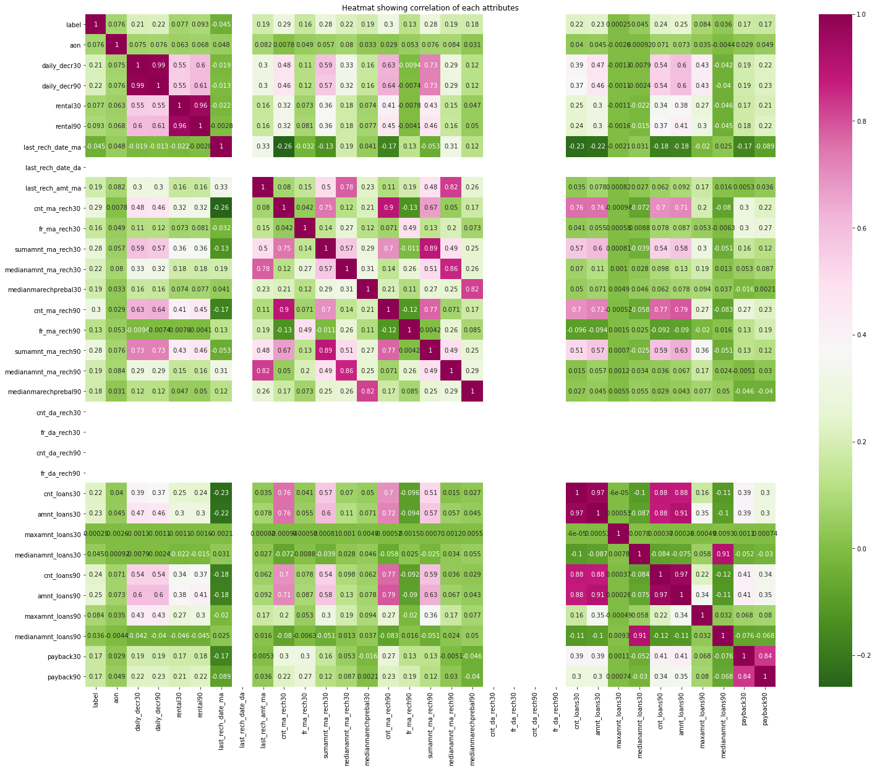
Heatmap: Heat map showing the correlation between the attributes. From the heatmap we observe that, 'amnt_loans30'&'cnt_loans90', 'daily_decr30 & daily_decr90' have strong correlation. We can remove one of the attributes to reduce multicollinearity.

Slide 14
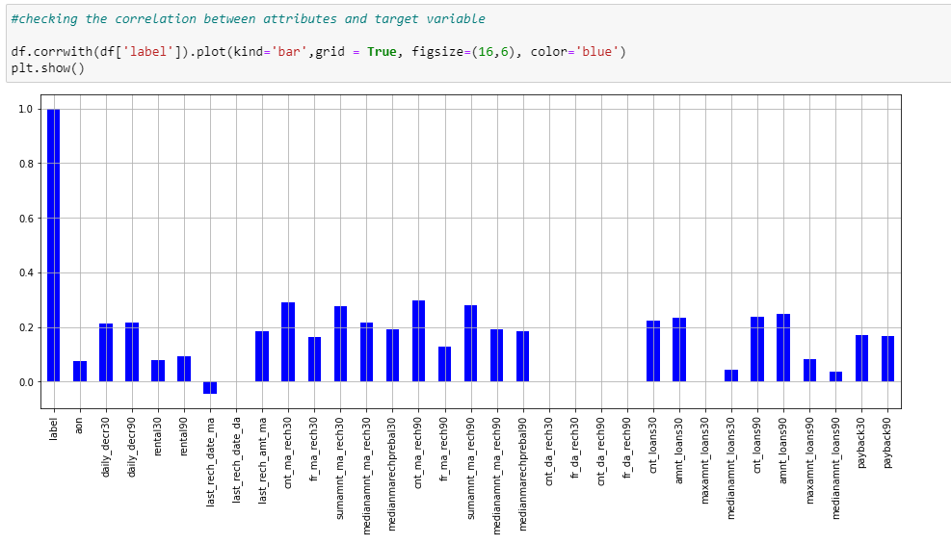
Correlation with target variable

Slide 15
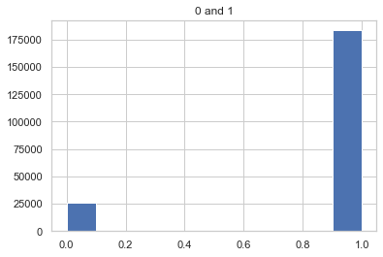
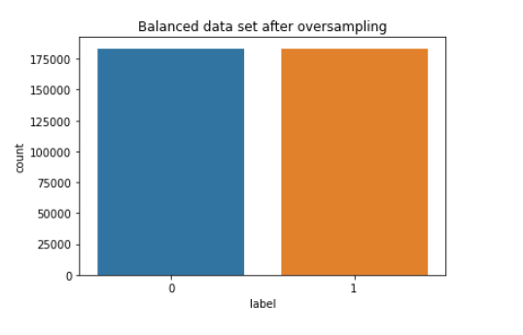
Resampling target data In the graph below, 0- shows loan defaulters customers. 1- shows percentage of loan non-defaulters' customers We have used random over-sampling technique to equalize the target variable.

Slide 16
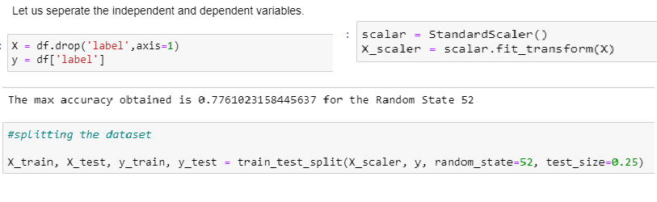
Identification of possible problem-solving approaches
The dataset provided has huge volume of the data which did not have any null values, but there were outliers present in the dataset, unless outlier treatment there is possibility of our machine learning model overfitting the data or increase the variability in the data.

Slide 17
Testing of Identified Approaches (Algorithms)
Logistic Regression
Logistic regression is a statistical analysis method to predict a binary outcome, such as yes or no, based on prior observations of a data set. A logistic regression model predicts a dependent data variable by analysing the relationship between one or more existing independent variables.
Random Forest Classifier
The random forest classifier is a versatile classification tool that makes an aggregated prediction using a group of decision trees trained using the bootstrap method with extra randomness while growing trees by searching for the best features among a randomly selected feature subset.
Decision Tree Classifier
A decision tree is a class discriminator that recursively partitions the training set until each partition consists entirely or dominantly of examples from one class.

Slide 18
Testing of Identified Approaches (Algorithms)
XGBoost Classifier
XGBoost is an implementation of gradient boosted decision trees designed for speed and performance that is dominative competitive machine learning.
KNN Classifier
K Nearest Neighbors(KNN) is a very simple, easy to understand, versatile and one of the topmost machine learning algorithms. KNN used in the variety of applications such as finance, healthcare, political science, handwriting detection, image recognition and video recognition

Slide 19
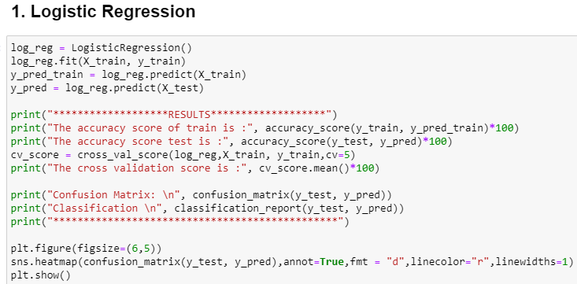
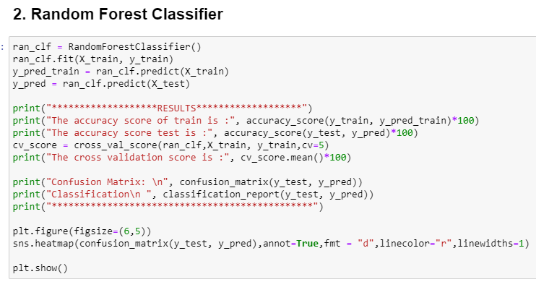
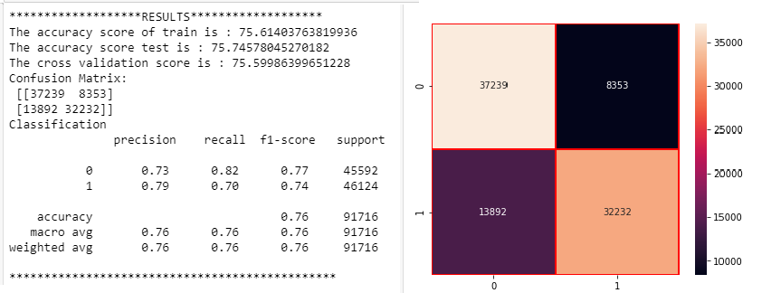
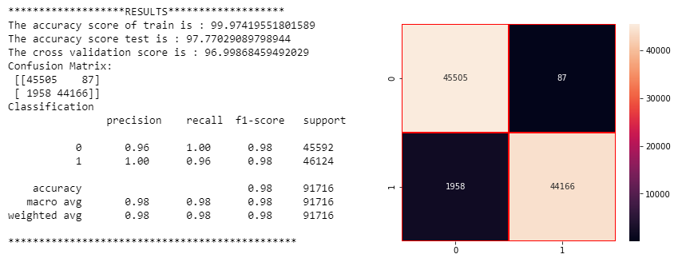
Run and Evaluate selected models

Slide 20
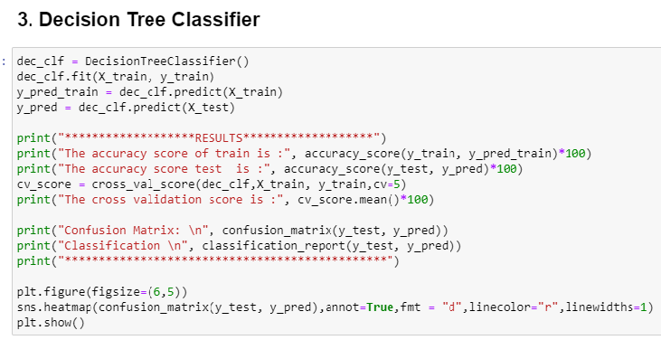
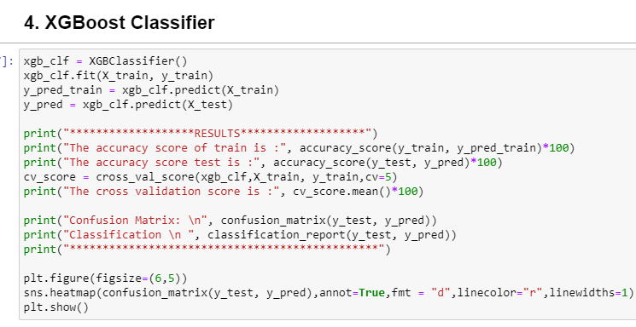
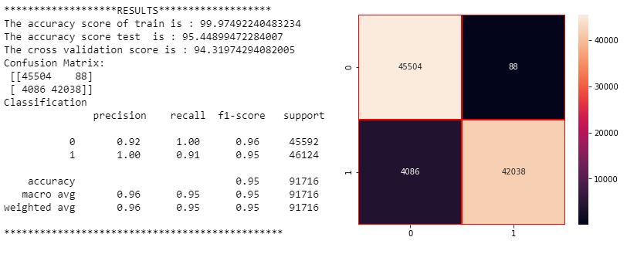
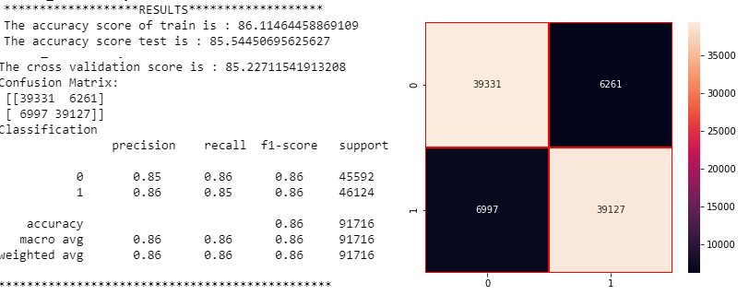
Run and Evaluate selected models

Slide 21
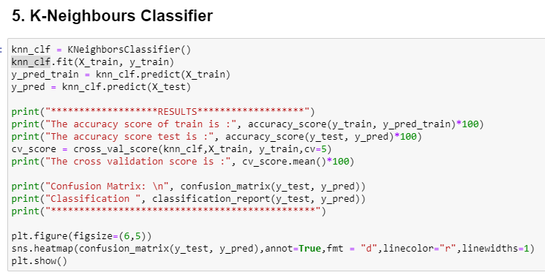
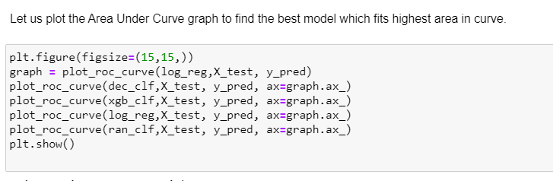
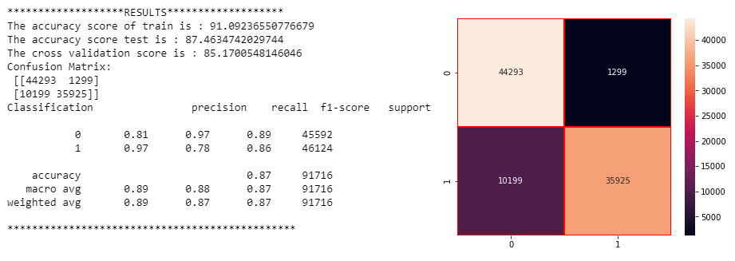
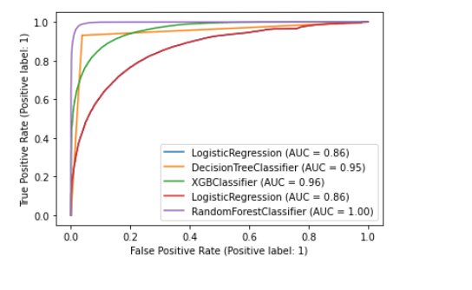
Run and Evaluate selected models

Slide 22
Conclusion
We have trained several models above for the dataset we had prepared, and we got different results for different algorithm.
The data set consist of large number of outliers which hinders the performance of machine learning models. Unless we solve the outlier problems, we are not reaching the best model accuracy. One can focus on collection of real time customer-oriented data which can be useful for EDA. And more inference can be provided based on the analysis.
We see that Random Forest classifier model has given the highest AUC in graph, the accuracy score of 97% and CV score of 96% which is highest among all the models tested also, we see that evaluation metrics are high for this model. Hence, we will be saving this model.

